Slide 1
Membrane Transport
- The cytoplasmic membrane is beneath the Cellwall and is approximately 7.5 nm thick and is composed of phospholipids(20 to 30%) and proteins (60 to 70%).
- phospholipids form a bilayer, in which globular proteins are embedded either in extrinsic (peripheral) or intrinsic (integral) position.
- The primary function of CM is to regulate the flow of material in to and out of the cell. It is a semipermeable barrier.

Slide 2
- The chemical composition of CM is key to regulate the specific transport processes.
- the fundamental structure of CM of all cell is described by Fluid Mosaic Model of Singer and Nicolson (1972).
- According to this model, Biological membranes are considered to be quasifluid structures in which lipids and proteins are arranged in a mosaic manner.

Slide 3
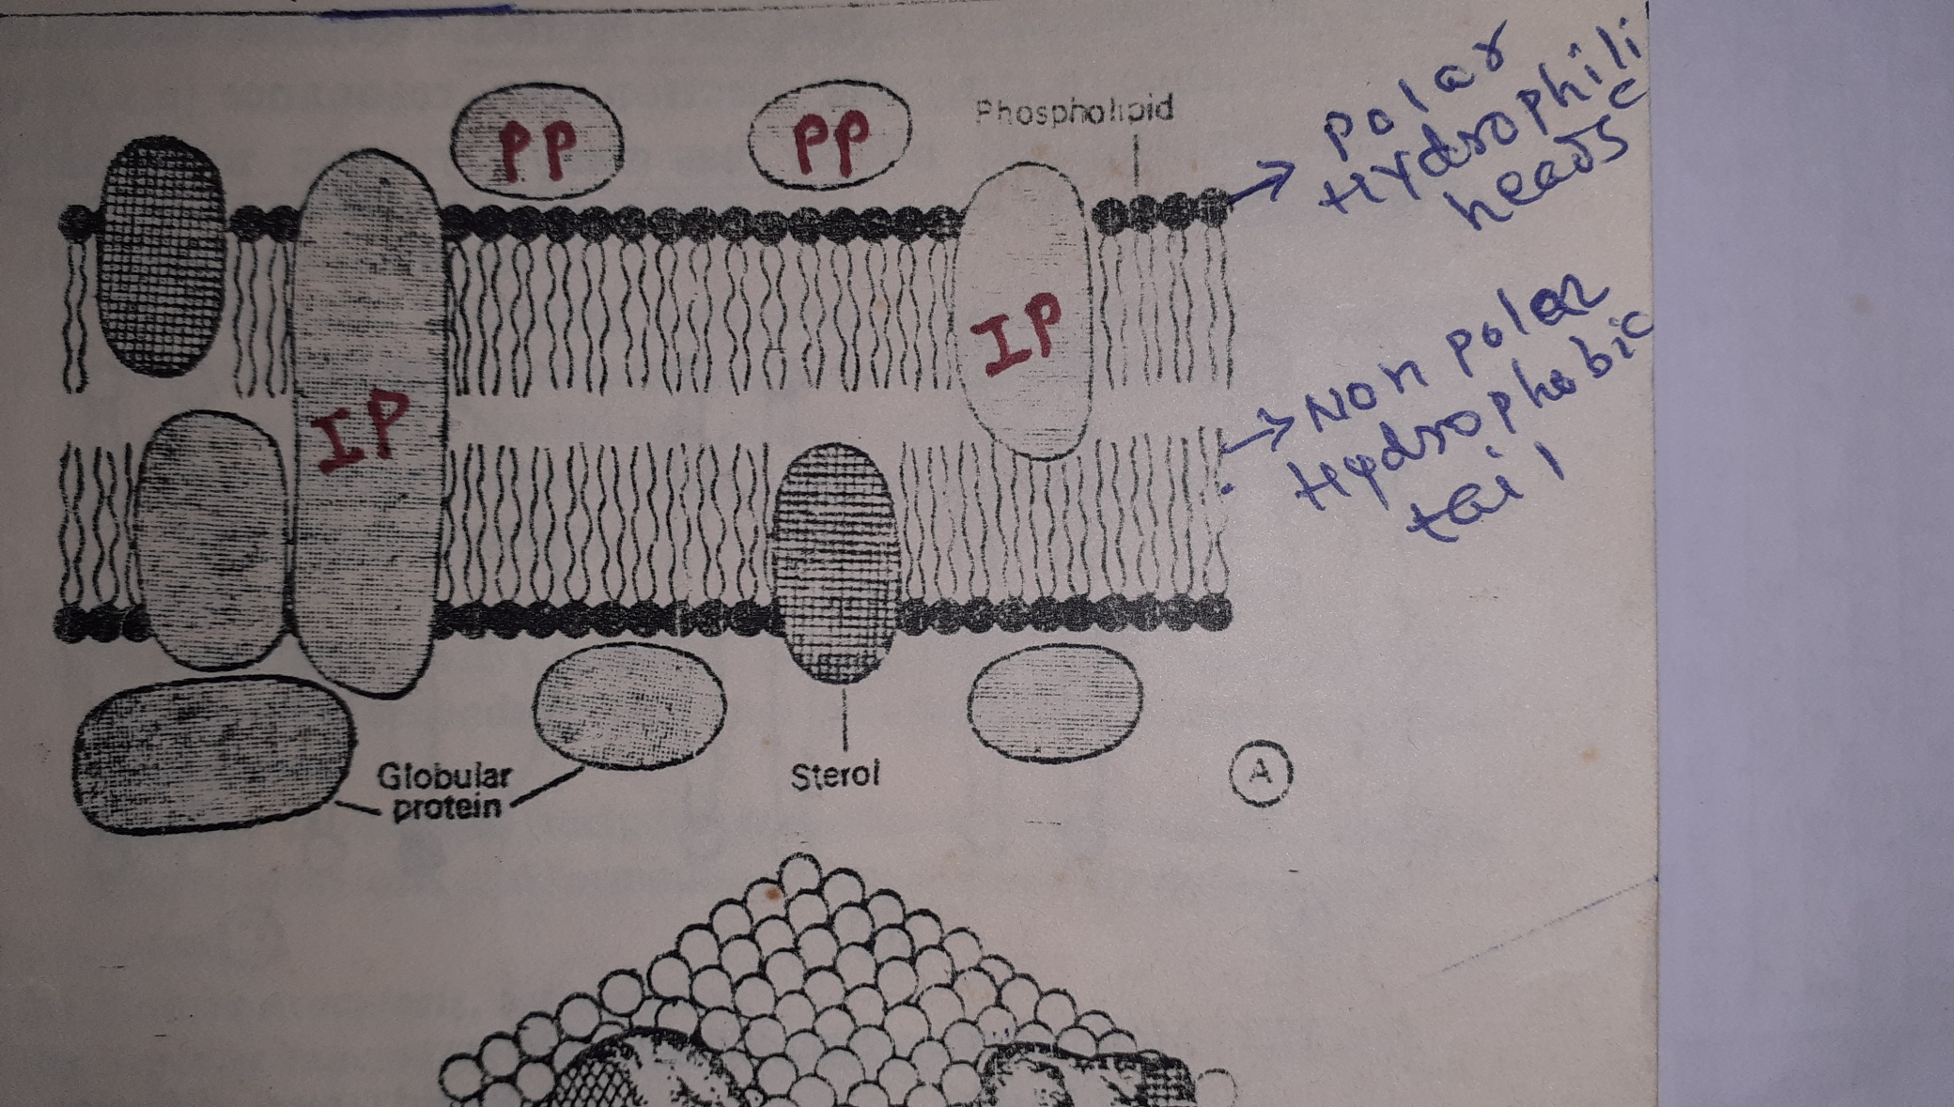
Fluid Mosaic Model of Singer and Nicolson (1972).

Slide 4
Nutrient transport across the membrane
  Cells have various transport mechanisms for moving molecules across the cytoplasmic membrane.
  Transport mechanisms are distinguished by following characteristics :
  1. Whether the molecule passes directly through the lipid layer or via a specific protein membrane channel.
  2. Whether the molecule is altered as it passes through membrane.
  3. Whether the process requires cellular energy.
  4. Whether solutes are concentrated against gradient.

Slide 5
  Two Main Transport processes :
  1. Passive Transport processes
  2. Active energy linked Transport processes
  Passive Transport processes :
  - Transport mechanisms that do not require any expenditure of cellular energy are considered passive processes.
  Includes - Passive Diffusion, Osmosis and Facilitated diffusion.

Slide 6
  - Movement of molecules from a region of higher concentration to one of lower conc. is known as Diffusion .
  When the conc. of a substance are different on opposing sides of a cytoplasmic membrane there is a concentration gradient of that substance across the membrane, the molecule will move across the cytoplasmic membrane by diffusion until equilibrium occur – i.e equal conc. exist on both the sides of the membrane.

Slide 7
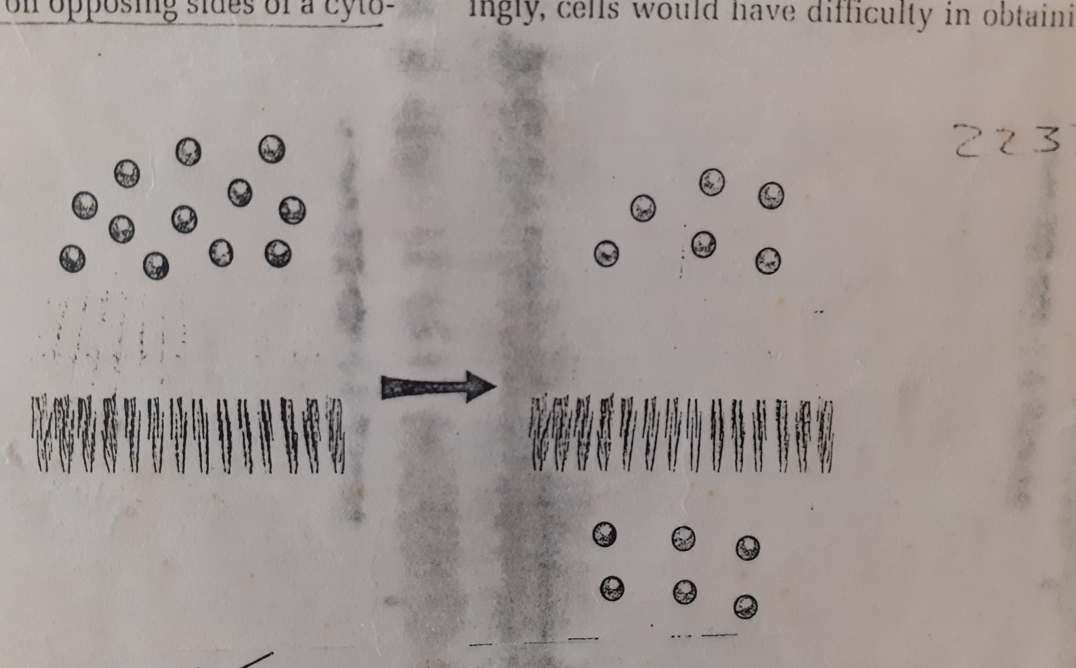
  Passive Diffusion :
  Unassisted movement from areas of high conc. to a areas of low conc. (i.e along the conc. gradient) is called Passive diffusion.

Slide 8
  The rate of passive diffusion are determined by :
  1. the concentration gradient and
  2. the permeability of the cytoplasmic membrane .
  - The greater the conc. difference across the membrane and the greater the membrane permeability , the rate of passive diffusion is more.

Slide 9
  In some cases, when a substance moves in to cell it binds with other substances , forming complexes or it is metabolically transformed – prevents a buildup in the conc. of substance within a cell and the conc. gradient is maintained.
- This allows a substance to diffuse in a cell at a faster rate, but the rate of passive diffusion across the cytoplasmic membrane are still relatively slow.

Slide 10
- Passive diffusion takes place through the pores which arises in a random manner and are transitory.
- It does not involve steriospecificity( i.e - both L and D forms moves across the cytoplasmic membrane at equal rate).

Slide 11
Osmosis :
- The process by which water crosses the membrane in response to the conc. gradient of the solute is known as Osmosis.
- Some solute can not move across the cytoplasmic membrane , therefore water moves across in to balance the conc. of solutes.
- Water will move across the cytoplasmic membrane from the region of lower solute conc. to the region of higher conc. until these concs. are equalized on both the side of the membrane.

Slide 12
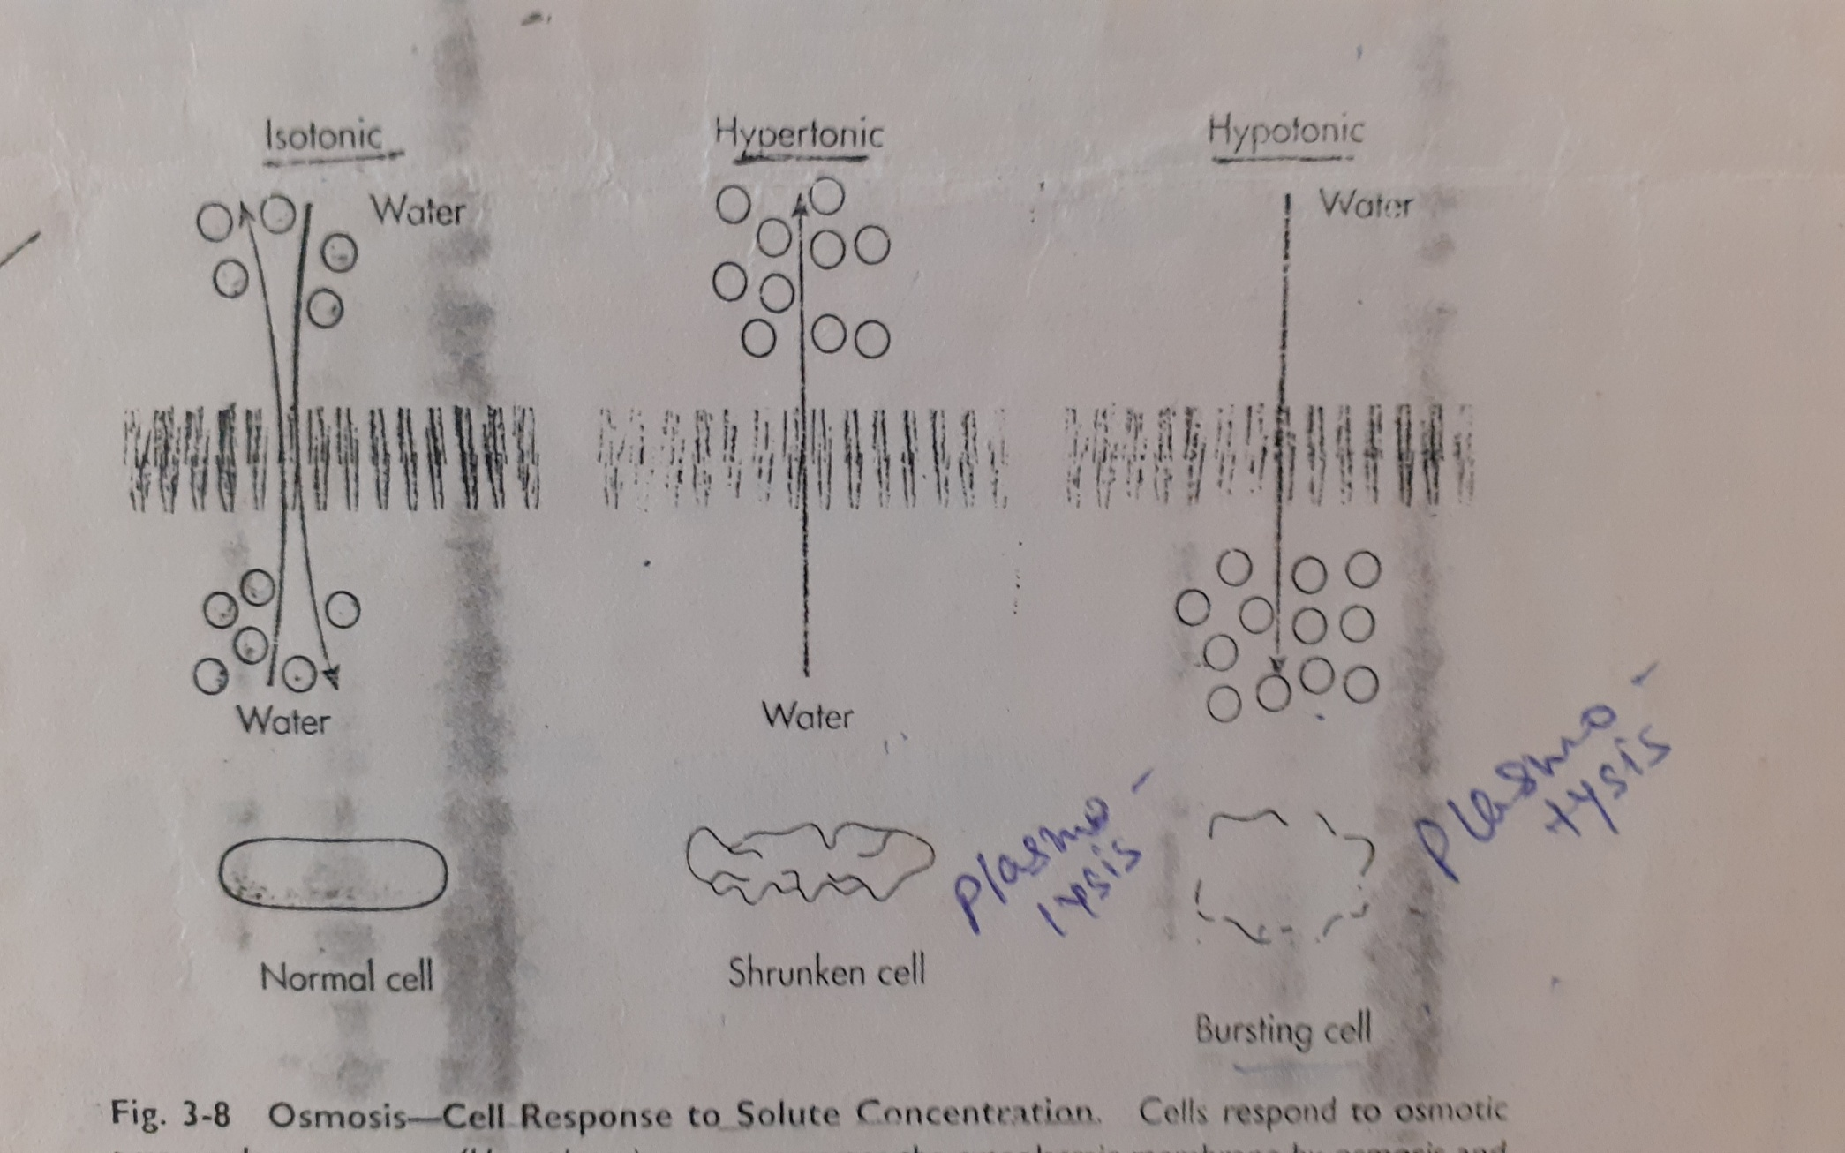
Osmosis

Slide 13
- In a medium in which the solute conc. Inside the cell is equal to the solute conc. outside the cell is known as Isotonic. Water will flow in both the direction across the membrane.
- In a medium in which the solute conc. is higher outside than inside the cell is known as Hypertonic. Water will flow outside thecell and shrinkage of cell will take place the process is called Plasmolysis.

Slide 14
- Reverse is , In a medium in which the solute conc. is lower outside than inside the cell is known as Hypotonic. Water will flow inside the cell and bursting of cell will take place the process is called Plasmotysis.
- Movement of water by osmosis generally is in to the cell, because there is a usually a higher conc. of solute within the cytoplasm. This movement of water by osmosis exerts a pressure on cytoplamic membrane, known as Osmotic Pressure.
- Cell lysis due to excess of osmotic pressure is called Osmotic Shock.

Slide 15
Facilitated diffusion :
- is a diffusion at an enhanced rate.
- The solute movement is from a region of
high conc. to one of low conc. and occurs
more rapidly.
the enhanced rate of diffusion depends on
specific proteins called facilitator proteins
or membrane transport proteins.

Slide 16
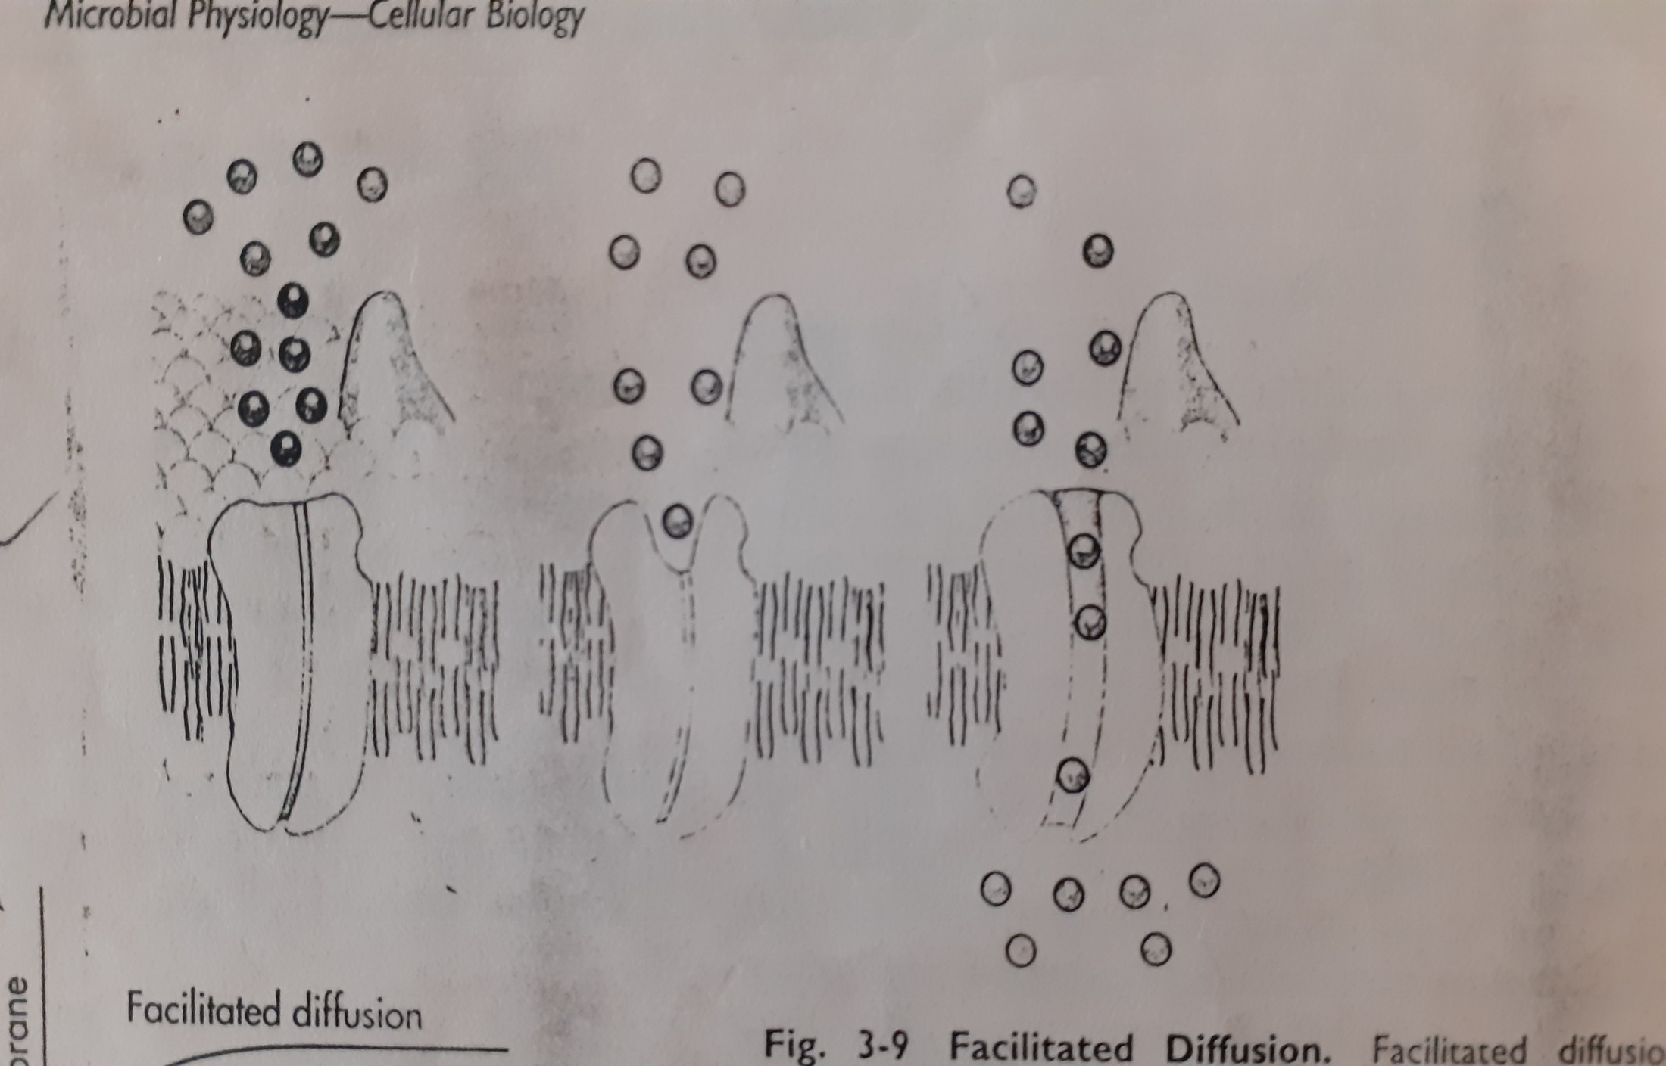

Slide 17
- These facilitator proteins selectively increase the permeability of the membrane , for specific solute to cross the membrane. These proteins are quite specific.
- They act as carriers, picking the molecule from one side of membrane to the other side.
- binding of solute to a facilitator protein alter the three dimensional properties of the protein and change in shape allow the solute to be moved or carried across the membrane.

Slide 18
Active Energy Linked Transport Processes
- Transport mechanisms that require expenditure of cellular energy are considered Active processes.
- Include : Active Transport, Group Translocation, Binding protein transport.
  Active Transport :
  - Active transport in which cells use metabolic energy to move substances across the cytoplasmic membrane against conc. gradient from a region of a low conc. on one side of the membrane to a high conc. on the other side.

Slide 19
  substance is not chemically modified.
  In Active transport, Permeases - transmembrane proteins acts as carriers to move substances across the membrane.
  Different permeases for specific substrates e.g the lactose permease of E.coli transport lactose using energy of electrochemical gradient.
  Electrochemical gradient acts to change the shape of the carrier so that the substrate can be moved across the membrane.

Slide 20
  Some Permeases carry only one substance at a time and are referred to as Uniporters .
  Other permeases can carry more than one type of substrate are called Cotransporters.
  In Cotransporter two types of movement are possible :
  1. Two substrates may be carried across the membrane in the same direction simultaneously e.g lactose is transported across the cytoplasmic membrane at the same time that a proton(H⁺) is transported. This is called Symport.

Slide 21
  2. Substrates may be transported across the membrane in opposite directions. e.g when Na⁺ are pumped outside the cell, at the same time that H⁺ is transported inside the cell. This mechanism is called as Antiport(Carried opposite).

Slide 22
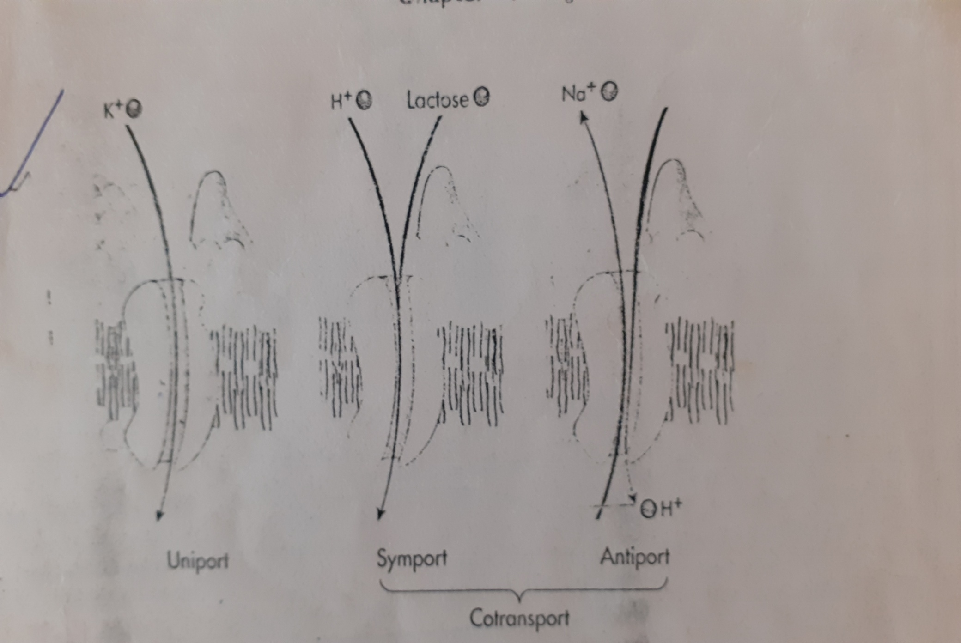
Uniport, Symport & Antiport

Slide 23
Ref : Principles of Microbiology By R.M. Atlas.

